Slide 1
Remote Storage
Yoel Kortick
Senior Librarian

Slide 2

Agenda
Introduction
Adding a Remote Storage Location
Testing the Setup

Slide 3
Introduction

Slide 4
Introduction
It is often the case that the library will have some items stored in a location which is considerably physically further away than most other locations.
Often the items which are stored in this "distant" location are in less demand than items in closer locations, where real estate may be more valuable and space more limited.
This "distant" location is typically referred to as "remote storage"
The loaning of the items typically does not occur at the remote storage but rather at another location to which they are transited for the purpose of loaning.

Slide 5
Introduction
When items are needed from the remote storage location they are
Transited from remote storage to the requested location
Checked out to a patron at the location
Checked in from patron at the location
Transferred back to the remote storage location

Slide 6
Introduction
The "Remote Storage" is a physical location similar to other locations.
In this sense it
  Belongs to a fulfillment unit
  Has fulfillment unit rules
  Items in the Remote Storage location behave according to a terms of use
  It has a Circulation Desk.

Slide 7
Introduction
As previously stated: Typically, there is no Check Out or Check In (loan or return) at the Remote Storage location.
In most cases items are transited from the Remote Storage location to a location which does do Check Out and Check In, and then transited back to the Remote Storage location
The location to which the item is returned may or may not do "Reshelve" to the Remote Storage location.

Slide 8
Introduction
In the scenario described in this presentation the remote storage is in a sense "just another location".
This location does not loan and return, is physically located "far" away from the rest of the locations, and primarily just transits items in and out.

Slide 9
Introduction
Note that there is also a different type of remote storage location which uses an external integration profile of type Remote Storage.
If a profile of this type has been configured and is running, then Alma will export a file of requests for items in the remote storage location and it will be placed on the defined ftp server.
The file may then be retrieved by the remote storage location and processed. This would be instead of or in addition to the task list "Requests – Pick from shelf".
This presentation does not use the remote storage type integration profile.

Slide 10
Adding a Remote Storage Location

Slide 11
Adding a Remote Storage Location
Here is what we will do now to add a Remote Storage Location
Add a new location of type "Remote Storage" in desired library. We will signify "Remote Storage" and "Remote Storage Offsite Facility" in the new "Remote Storage" location.
Define a new circulation desk which includes the new Remote Storage location and does reshelve for the Remote Storage Location.
Add the new Remote Storage location to an existing circulation desk where the items from the Remote Storage location will be checked in and checked out

Slide 12
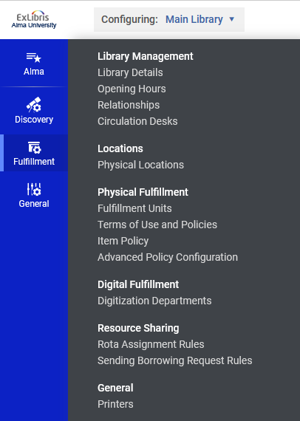
Adding a Remote Storage Location
From the general configuration menu switch to the library in which you want to add the Remote Storage location and choose "Locations > Physical Locations"
Library in which we will add a location

Slide 13
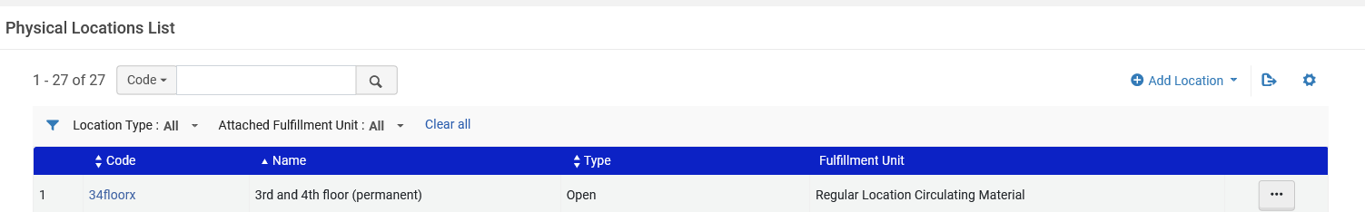
Adding a Remote Storage Location
From the list of existing physical locations click "Add Location"

Slide 14
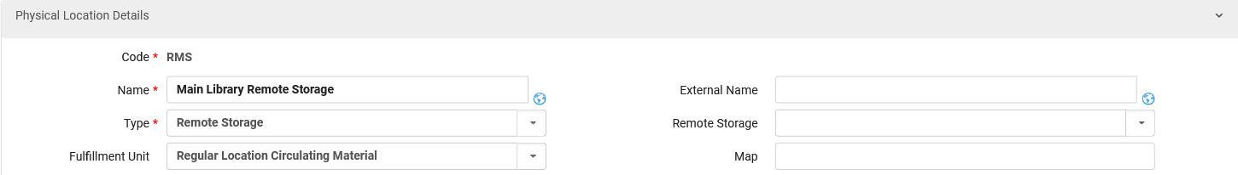
Adding a Remote Storage Location
Fill in the form.

Slide 15
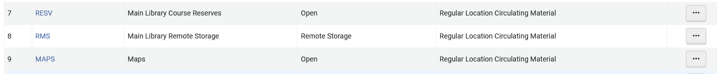
Adding a Remote Storage Location
Now the new Remote Storage location appears with the other locations for the library

Slide 16
Adding a Remote Storage Location
Now we will create a circulation desk for the Remote Storage location.
This may be done by
  adding it from the list of circulation desks
  by editing the location and then adding a new circulation desk.
We will edit the location and then add a circulation desk.

Slide 17
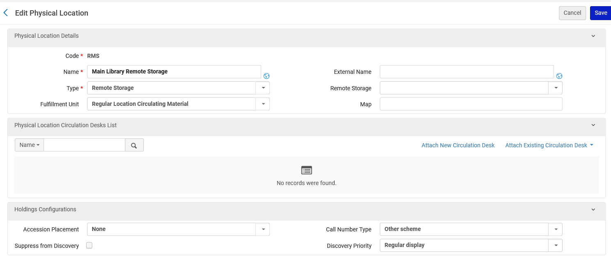
Adding a Remote Storage Location

Slide 18
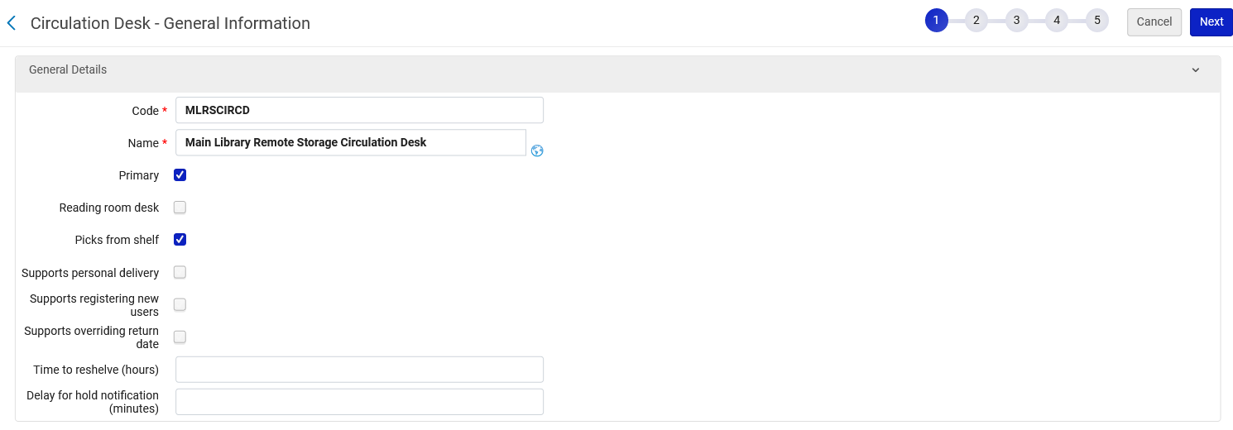
Adding a Remote Storage Location
The Remote Storage circulation desk

Slide 19
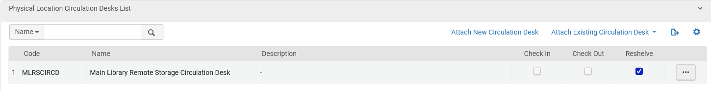
Adding a Remote Storage Location
In the Remote Storage circulation desk, the location of type "Remote Storage" does not Check In or Check Out, but it does reshelve

Slide 20
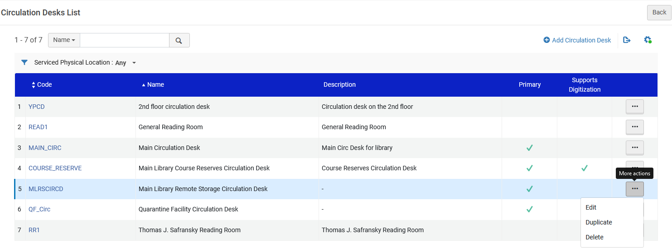
Adding a Remote Storage Location
Add the operator who can use this desk. Edit the circulation desk.

Slide 21
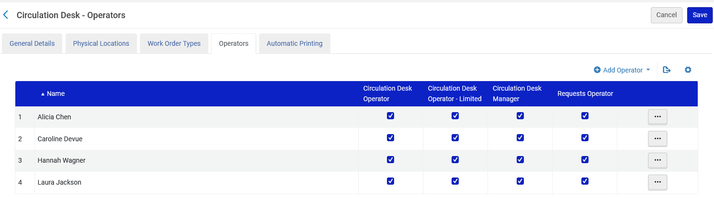
Adding a Remote Storage Location
Add the operators who can use this desk

Slide 22
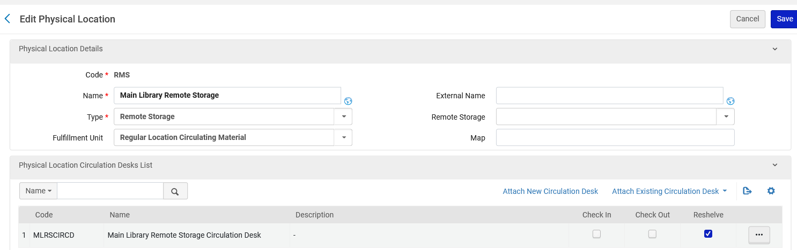
Adding a Remote Storage Location
Now we will attach an existing circulation desk to the Remote Storage Location
This will be a circulation desk where items will be checked in and checked out.

Slide 23
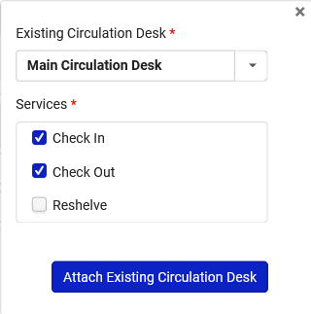
Adding a Remote Storage Location
Add an existing circulation desk from which item will be loaned and returned.
In this case the "Main Library Circulation Desk"
This circulation desk does Check In and Check Out but not Reshelve

Slide 24
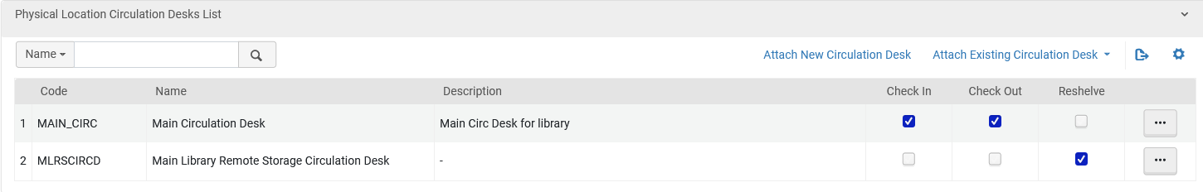
Adding a Remote Storage Location
Now the location has two desks:
Main Circulation Desk = the items will be loaned to patrons and returned from patrons at this desk. Therefore, it supports "Check In" and "Check Out" but not "Reshelve".
Main Library Remote Storage Circulation Desk = the items will be transited from and to the remote storage with this desk. Therefore, it does not support "Check In" and "Check Out" but does support "Reshelve".

Slide 25
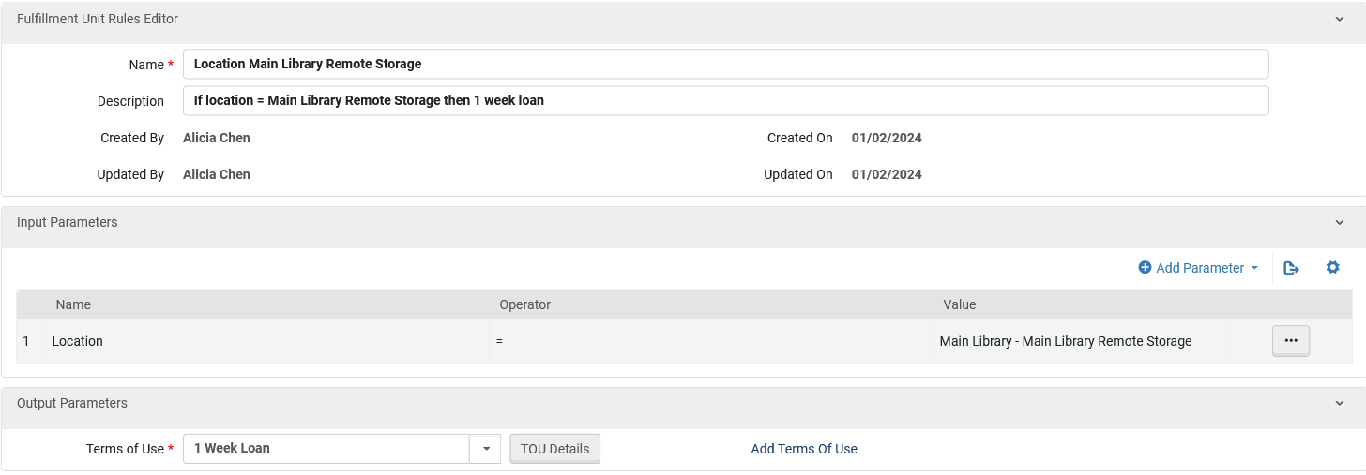
Adding a Remote Storage Location
Make sure there is a fulfillment unit loan rule for items in this location (if your rules are location based)
Fulfillment Unit Rule for loan

Slide 26
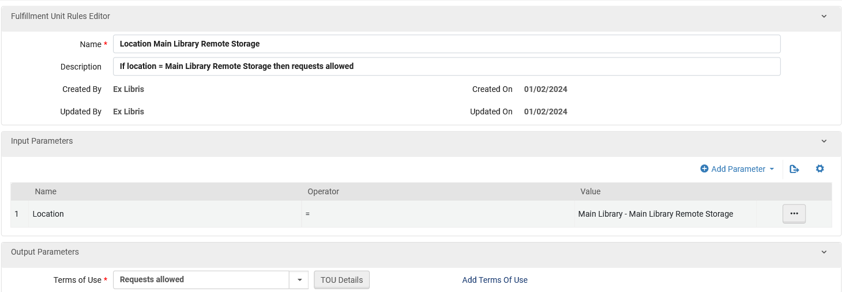
Adding a Remote Storage Location
Make sure there is a fulfillment unit request rule for items in this location (if your rules are location based)
Fulfillment Unit Rule for requests

Slide 27
Testing the Setup

Slide 28
Testing the Setup
We will now go through a typical workflow:
Item is in Remote Storage location
Item is requested for pickup at non remote location
Item appears in "pick from shelf" list of remote location
Item is scanned in at remote location
Item is transited to the non-remote location where it was requested
Item is loaned then returned at the non-remote location
Item is transited back to the remote location.

Slide 29
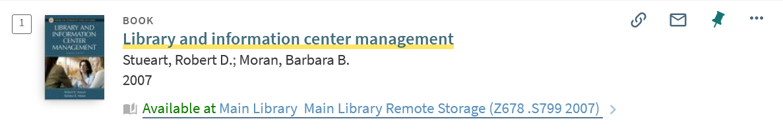
Testing the Setup
Here is an item in the remote storage location viewed by a user in discovery

Slide 30
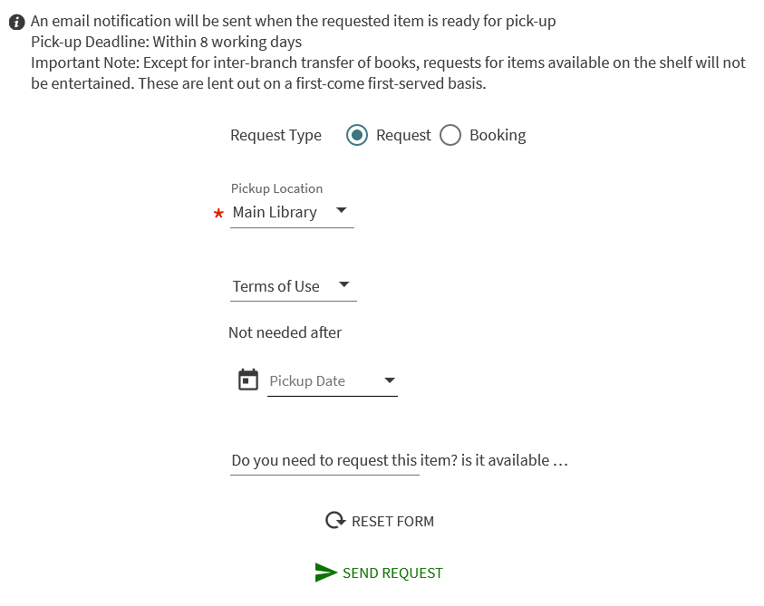
Testing the Setup
A patron places a physical item request on the item and designates to pick it up at the Main Library.

Slide 31
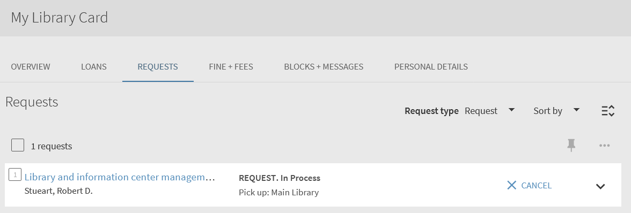
Testing the Setup
The request was successfully created. Here it is in the patron card

Slide 32
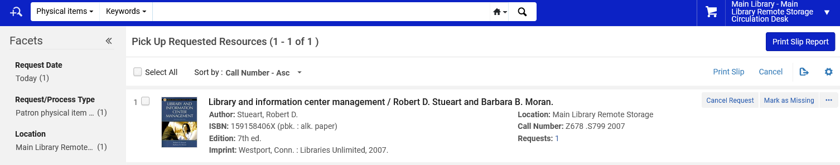
Testing the Setup
A staff user at the "Main Library Remote Storage Circulation Desk" accesses the "Pick from Shelf" list via "Fulfillment > Resource Requests > Pick from Shelf".
The user sees the request for the item at the "Main Library Remote Storage Location"

Slide 33
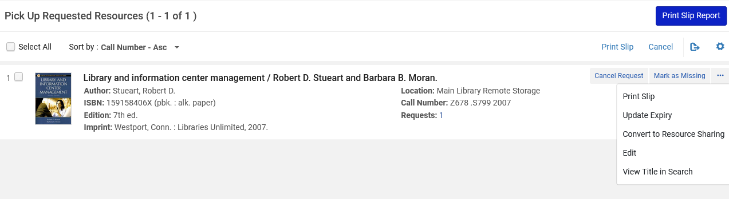
Testing the Setup
A slip is printed to pick from shelf

Slide 34
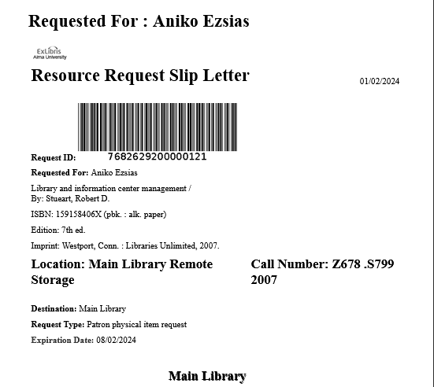
Testing the Setup
Here is the Print Slip

Slide 35
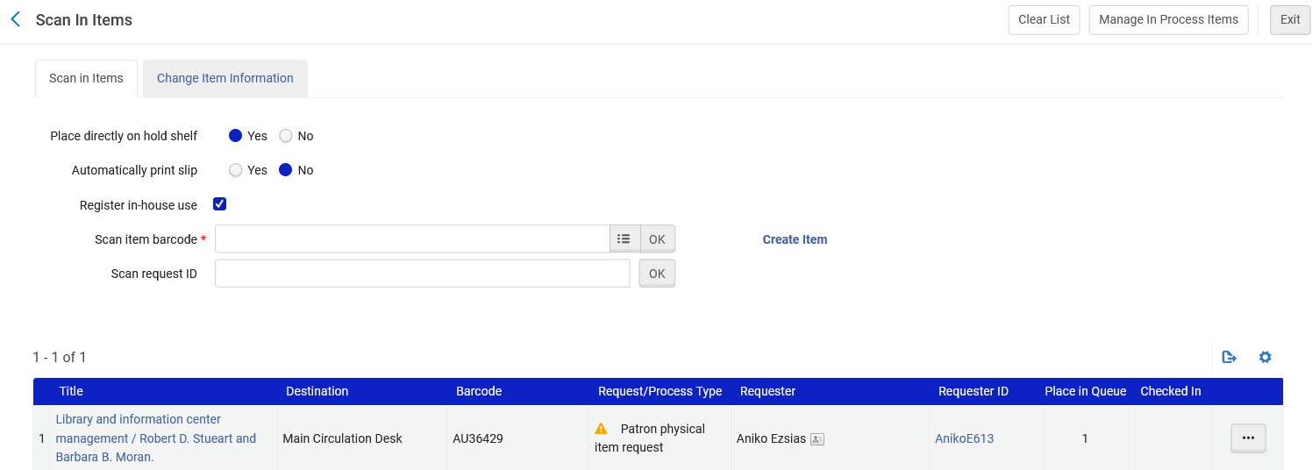
Testing the Setup
Item is scanned in at the remote storage desk
The destination is to the Main Library Circulation Desk

Slide 36
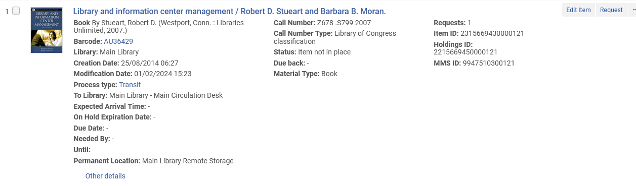
Testing the Setup
The item is visible in Alma as in transit to the Main Library Circulation Desk

Slide 37
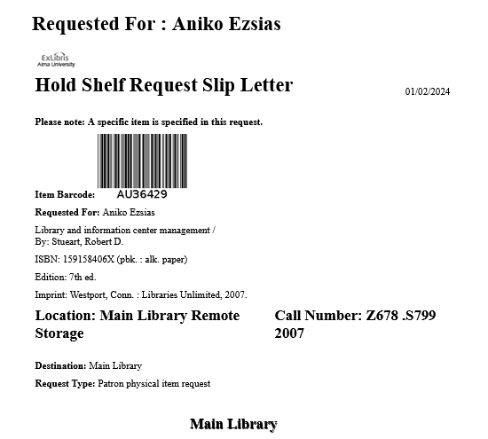
Testing the Setup
The item is then scanned in at the Main Library default circulation desk and goes on the hold shelf. Here is the Hold Shelf Request Slip Letter.

Slide 38
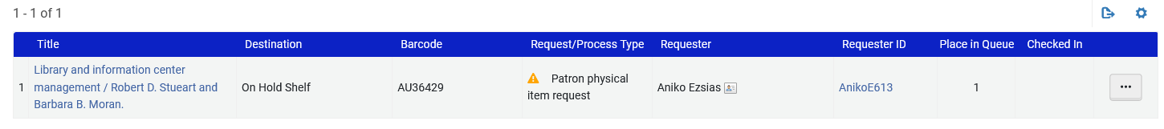
Testing the Setup
After scanning in, the item goes in the Hold Shelf

Slide 39
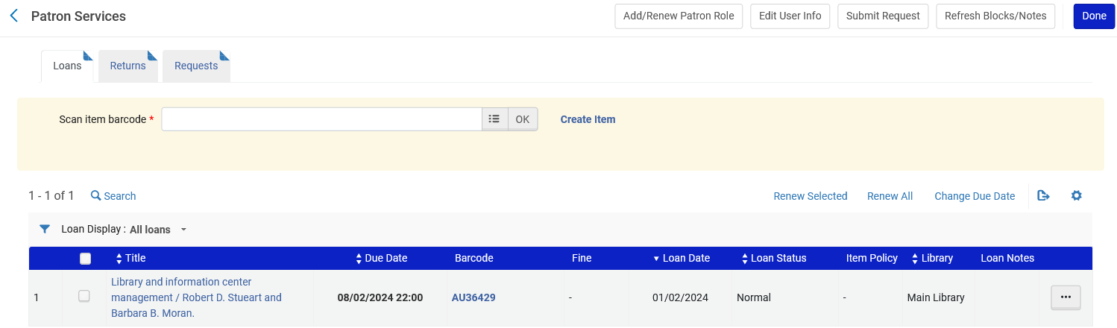
Testing the Setup
The item is loaned to the patron at the Main Library default circulation desk.

Slide 40
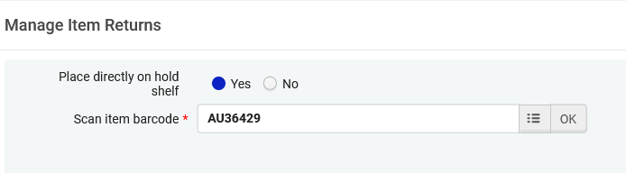
Testing the Setup
The item is returned at the Main Library default circulation desk

Slide 41
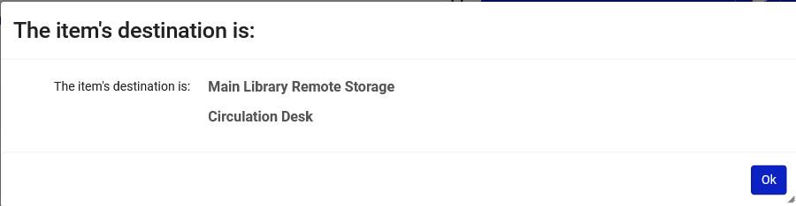
Testing the Setup
When the item is returned at the Main Library default circulation desk the following message will appear, ensuring that the item will not be put with items of the wrong location

Slide 42
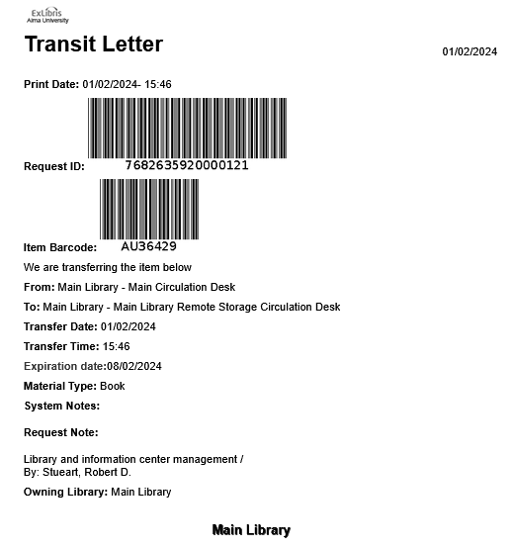
Testing the Setup
A transit letter is also printed

Slide 43

Testing the Setup
After the item is returned it will appear "in transit" to the remote storage location.

Slide 44
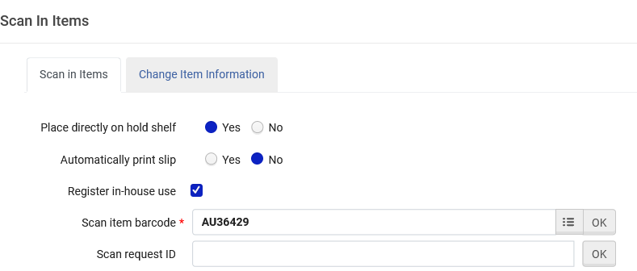
Testing the Setup
The item arrives to the remote storage location, gets scanned in.

Slide 45
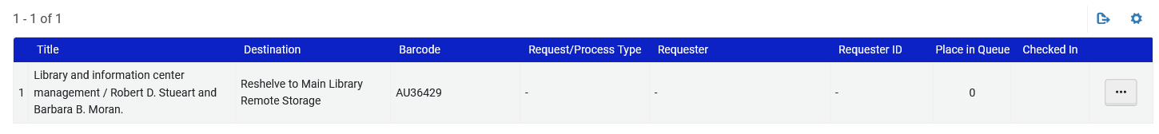
Testing the Setup
The item gets a destination to be reshelved.

Slide 46
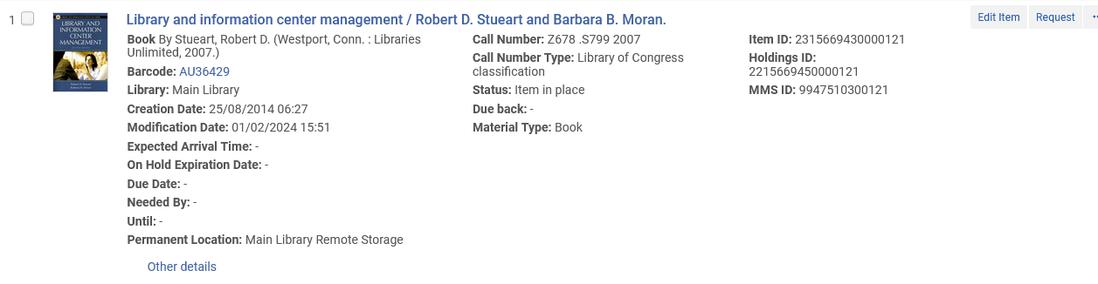
Testing the Setup
The item is back in place and the process is complete

